Slide 1
Calgary floods June 2013
Presentation of maps

Slide 2
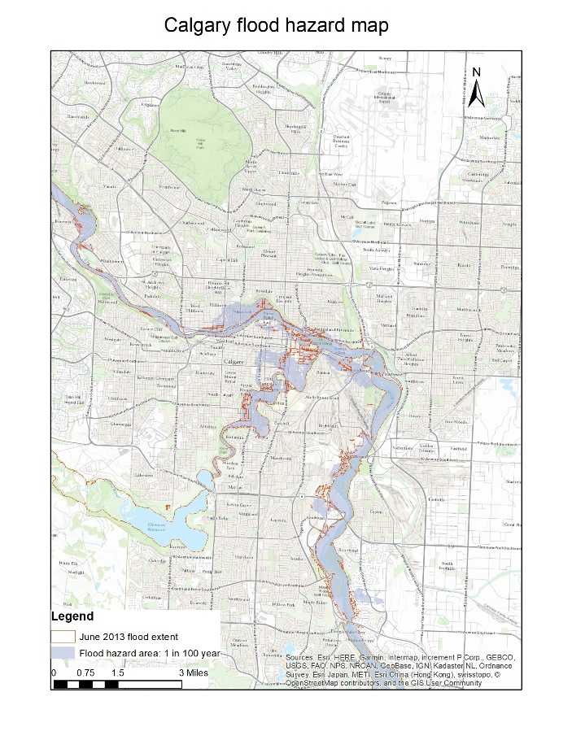
Calgary experienced 1 in 100 years flooding along the Bow and Elbow rivers in June 2013
Blue shaded region : 100 year flooding areas provided by the city of Calgary
Red outline: Actual areas flooded in June 2013 provided by the city of Calgary
Map made using ArcGIS

Slide 3
False color composite images using ENVI
Landsat 8
from Earthexplorer website
Blue lines 1:100 year flood region

Slide 4
False color composite images using ENVI

Slide 5
False color composite images using ENVI

Slide 6
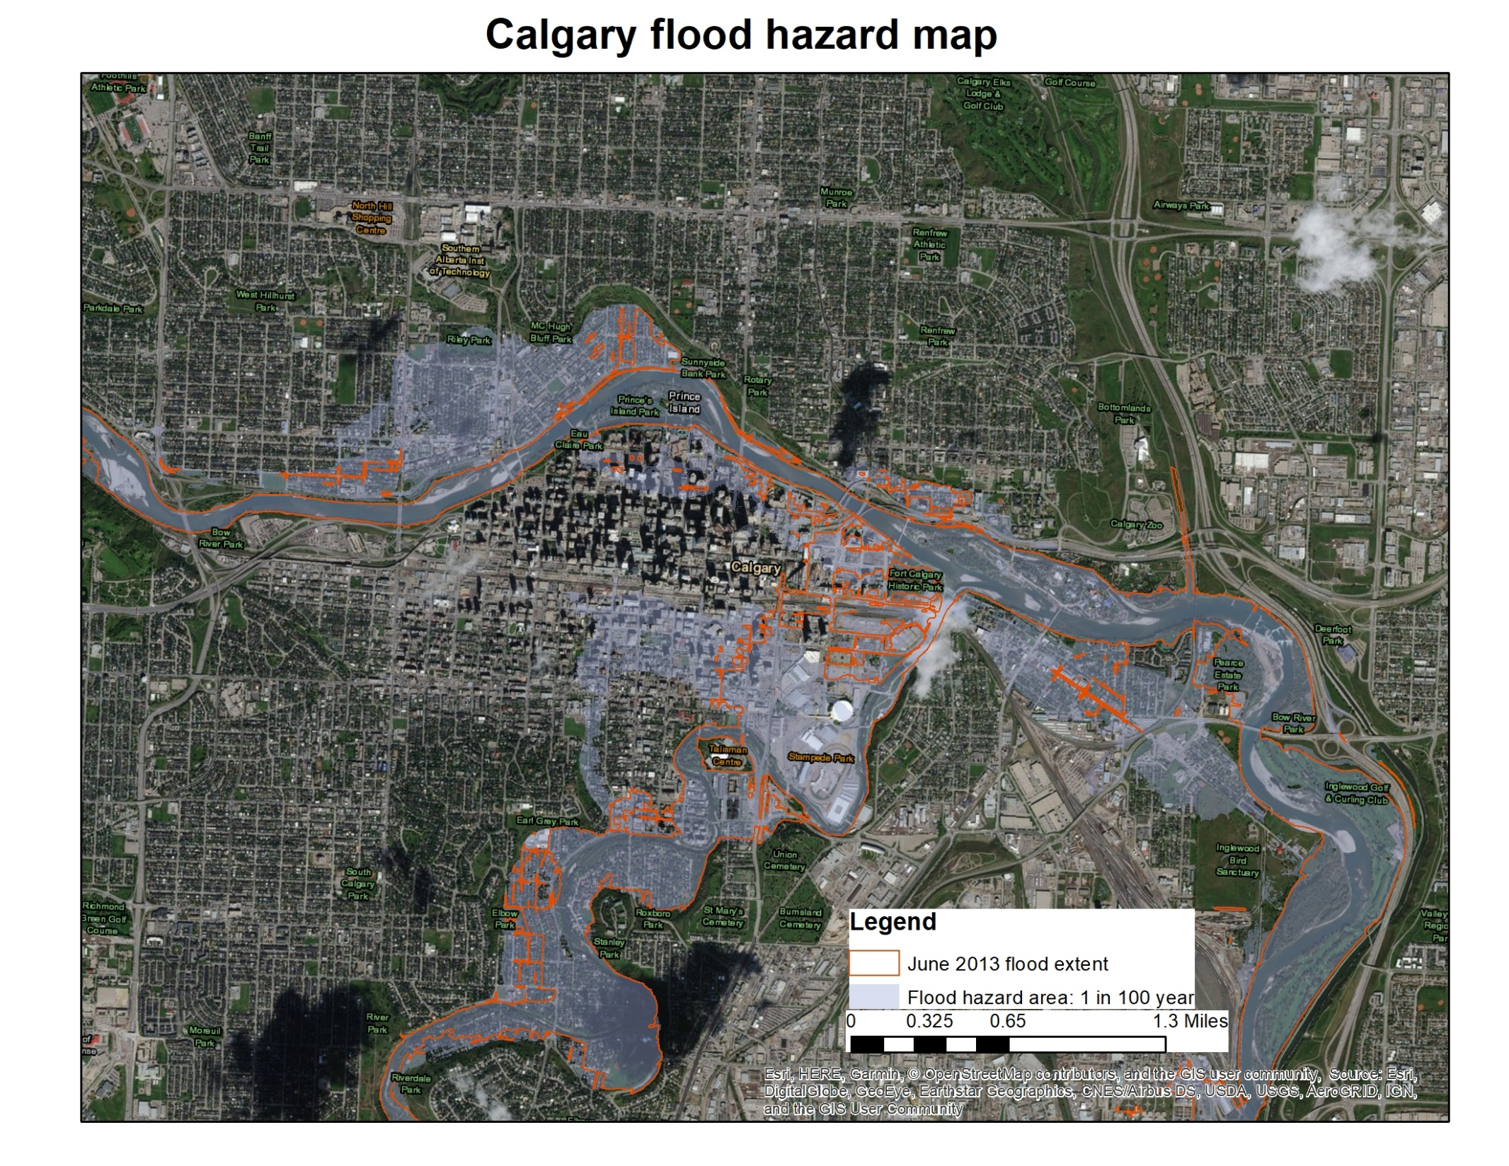
ArcGIS map
Downtown Calgary
Flooding near Calgary Stampede Park and downtown communities

Slide 7
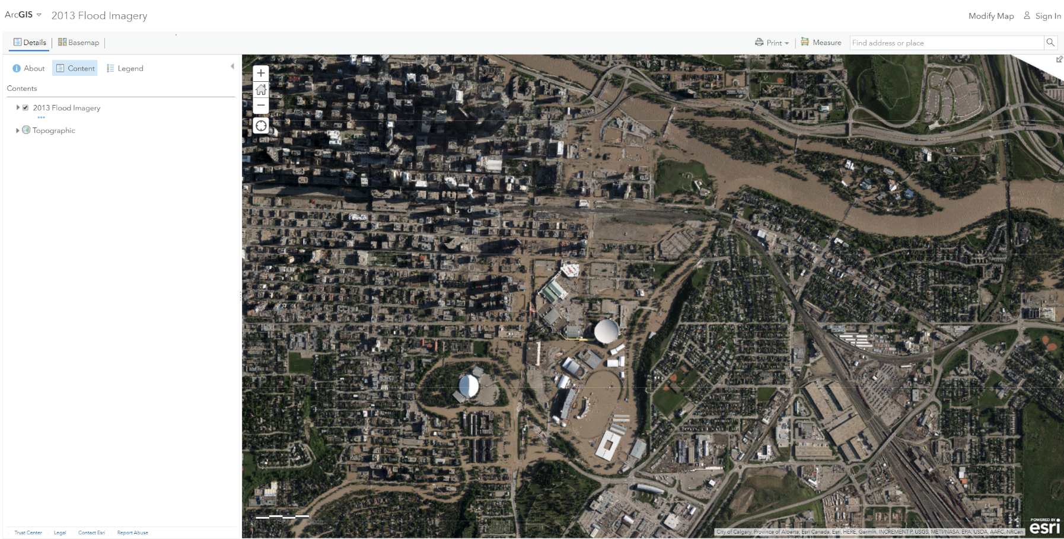
Orthophoto from Arcgis website
https://www.arcgis.com/home/webmap/viewer.html?useExisting=1&layers=c20a980704364d459397b5cf69334752

Slide 8
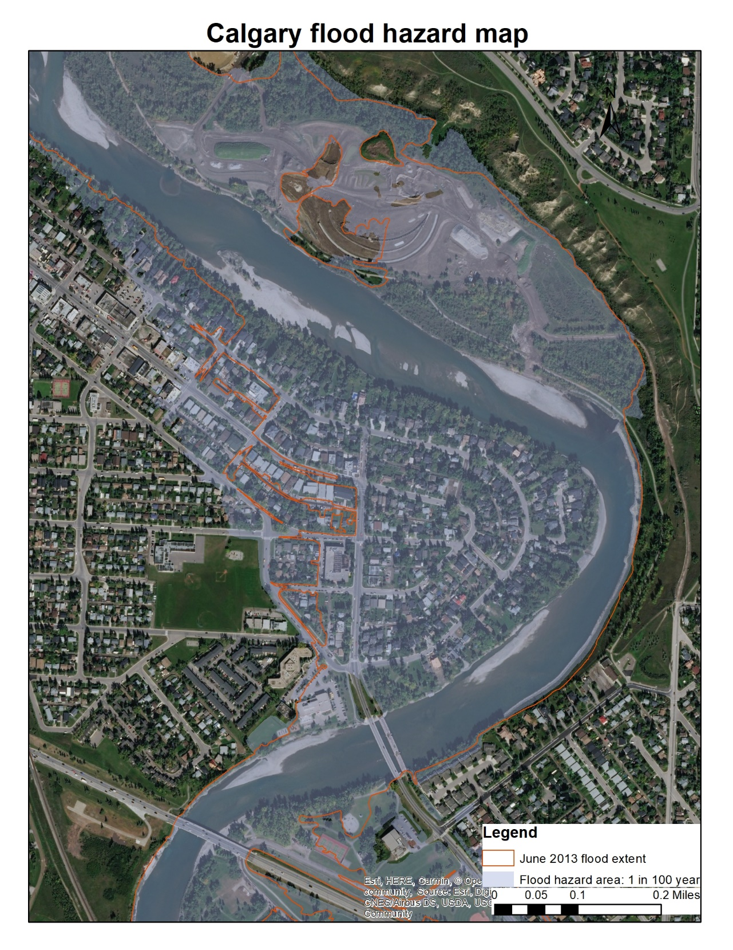
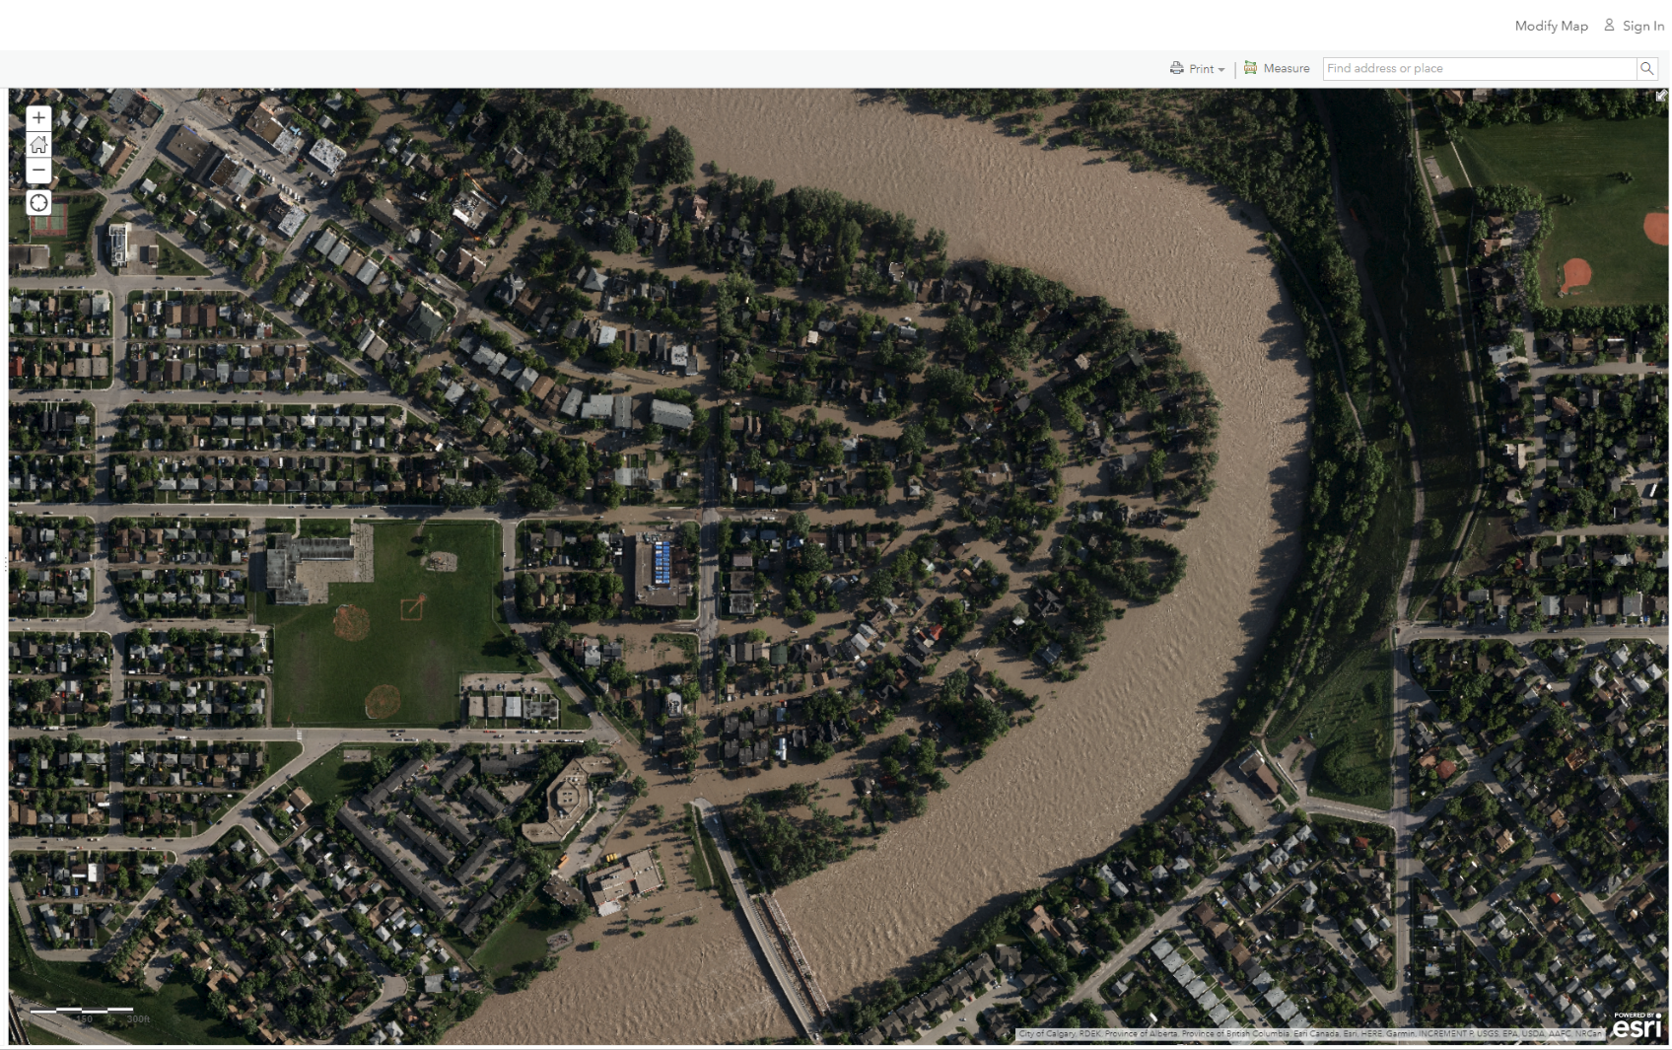
Calgary Bowness community

